Slide 1

ANZ Virtual Internship Program
Task 2:Prediction Task
Kasun Bandara
PhD Student
Monash University, Melbourne

Slide 2
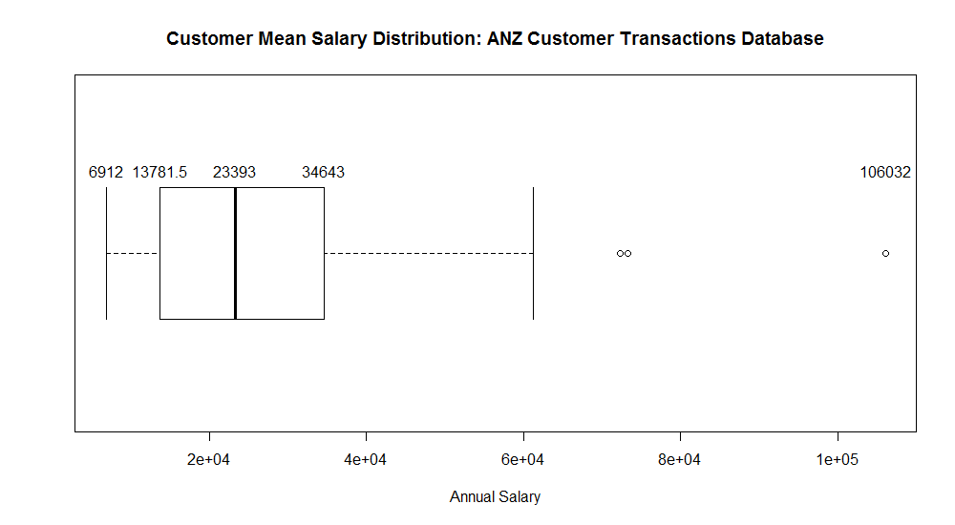
Annual Salary Analysis : ANZ Customer Database
annual_salary_summary <- df_anz %>% group_by(customer_id) %>% filter(txn_description == "PAY/SALARY") %>% summarize(Salary= round(mean(amount)*12))
Filtered by the “PAY/SALARY”, transaction description. Extracted, customer id, age, long_lat, and gender for later modelling purposes.
Several outliers (3 in total), representing highly income customers in the customer database
Potential target customer group for the ANZ (e.g. credit card campaigns')

Slide 3
Additional Feature Engineering : ANZ Customer Database
Total annual purchase: The total amount of money spent by the customers on purchasing transactions per year (excluding other transaction types)
annual_purchase_summary <- df_anz %>% group_by(customer_id) %>% filter(!(txn_description %in% c('PAY/SALARY',"INTER BANK", "PHONE BANK","PAYMENT"))) %>%summarize(Purchase= round(mean(amount)*12))
State Resides in: The name of the Australian state, which the customer lives.
location <- revgeocode(c(lon_df[i], lat_df[i]))
states <- c("VIC", "NSW", "QLD", "NT", "JBT", "SA","TAS","WA", "ACT")
state_match <- stri_extract_all_regex(location, states)
state<- unlist(state_match[!(is.na(state_match))])
state_df[i] <- state

Slide 4
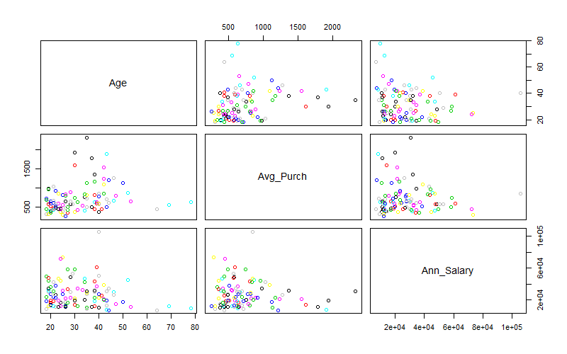
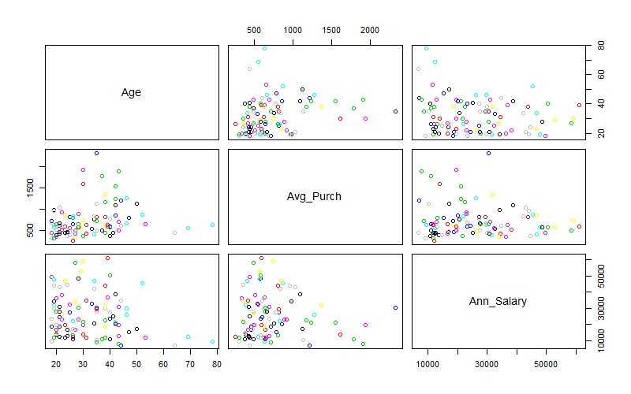
Correlation Analysis: ANZ Customer Database
Analysis based on with/without outliers, as identified through the previous analysis (only using the numerical features computed before)
With Outliers
Without Outliers

Slide 5
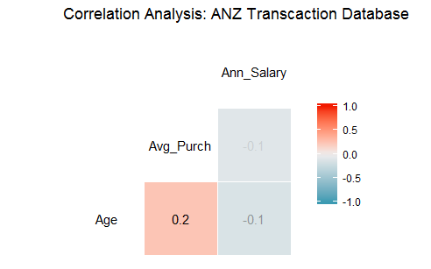
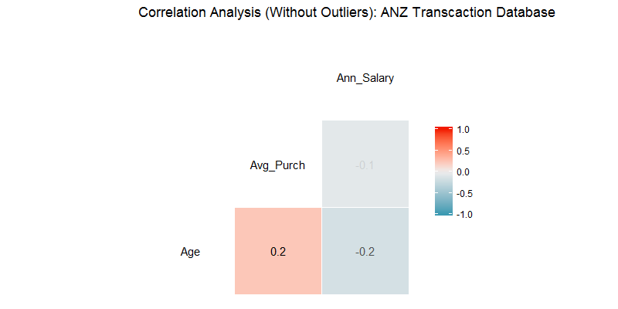
Correlation Analysis: ANZ Customer Database
Analysis based on with/without outliers, as identified through the previous analysis
Doesn’t appear to have a high correlations between the annual salary variable and any other explanatory variable .
However, we observe a small positive correlation (0.2) between the annual purchasing amount and the age.

Slide 6
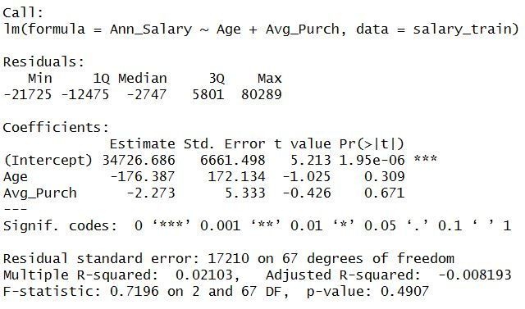
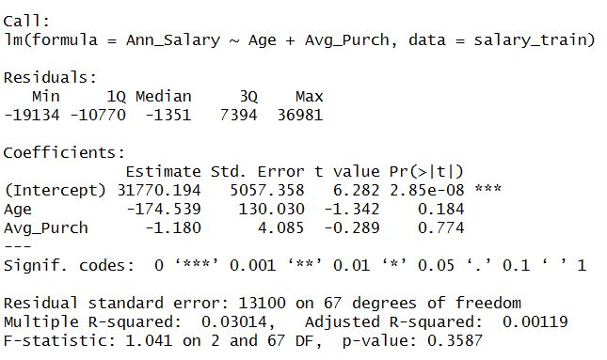
Regression Analysis: ANZ Customer Database
Only using the numerical features we engineered before.
Linear regression is usually sensitive to outliers, hence two versions are built
salary_model <- lm(Ann_Salary ~ Age + Avg_Purch, salary_train)
With Outliers
Without Outliers

Slide 7
Regression Analysis: Summary
R-squared values are very low, hence the models are not strongly fitted.
The p-values of each feature is rather high, meaning the existing variables doesn’t strongly represent or influence the annual salary of the customers (as discovered earlier through the correlation plot)
Testing the model :
With outliers (Model A) : 70 records to train the model and rest of the records (29) to evaluate the model
Without outliers (Model B) : 70 records to train the model and rest of the records (26) to evaluate the model
Model A performance: 15852.17 (Root Mean Squared Error (RMSE))
Model B performance: 14072.89 (Root Mean Squared Error (RMSE))
Model A and Model B performance cannot be compared with each other, as the size of the evaluation sets are different from each other. Out of sample RMSE needs to be calculated (using extra records) to assess the real performance of these models.

Slide 8
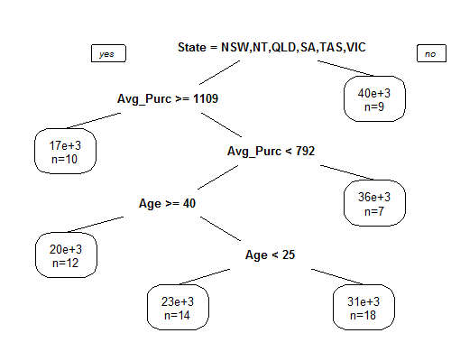
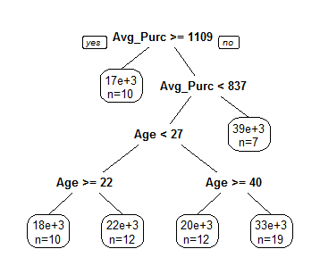
Decision Tree Analysis: ANZ Customer Database
Using all the features engineered earlier (numerical and categorical). This includes Age, Annual Purchasing, Gender, and the State
Two decision trees: With Outliers vs Without Outliers
prediction_tree <- rpart(Ann_Salary ~ ., data = salary_train)
Without Outliers
With Outliers

Slide 9
Decision Tree Analysis: Summary
Interestingly, in both the decision trees, “Gender Type” hasn’t recognised as an important feature when constructing the decision tree
Testing the model :
With outliers (Model C) : 70 records to train the model and rest of the records (29) to evaluate the model
Without outliers (Model D) : 70 records to train the model and rest of the records (26) to evaluate the model
Model C performance: 18669.96 (Root Mean Squared Error (RMSE))
Model D performance: 15785.71 (Root Mean Squared Error (RMSE))
Just like before, Model A and Model B performance cannot be compared with each other, as the size of the evaluation sets are different from each other.

Slide 10
Linear Regression Vs Decision Tree
Even though the decision tree has incorporated more variables (gender, location as extra variables), compared to linear regression, yet the simple regression has outperformed the preliminary results of the decision tree (Model A vs Model C , Model B vs Model D)
In general, decision trees are often robust to outliers. How ever, in this case, the structure of the decisions trees have changed drastically when outliers are excluded.
This may be due to the small number of records available in the dataset.
A proper evaluation needs to be conducted using a more larger customer database

